Slide 1
Delay analysis for flights to and from MSP
Team Delorean: Chi Tran, Erik Jakubowski, Tom Brennan, Mamta Mandan

Slide 2
The Source…
Monthly data for 2017 was pulled from the Bureau of Transportation Statistics
Concatinated monthly data and merged it with CSVs containing airline information and US airport information
Scrubbed data for relevant columns based on what information we would want to know as passengers
import glob
import pandas as pd
df = pd.concat([pd.read_csv(f, low_memory=False) for f in glob.glob('Resources/1028836041*.csv')], ignore_index = True)
airlines = pd.read_csv("Resources/airlines.csv")
airports = pd.read_csv("Resources/airports.csv")
combined_df = pd.merge(df, airlines, how='left', on='OP_UNIQUE_CARRIER')
combined_df = pd.merge(combined_df, airports[['AIRPORT','IATA_CODE']], how='left', left_on = 'ORIGIN', right_on = 'IATA_CODE',suffixes=(" ","_Origin"))
combined_df=combined_df.rename(columns={"AIRPORT":"ORIGIN_AIRPORT"})
combined_df = pd.merge(combined_df, airports[['AIRPORT','IATA_CODE']], how='left', left_on = 'DEST', right_on = 'IATA_CODE',suffixes=(" ","_Origin"))
combined_df=combined_df.rename(columns={"AIRPORT":"DEST_AIRPORT"})

Slide 3

The Basics…
Number of outbound flights in a year: 145,826
Number of inbound flights in a year: 145,798
Airlines: Alaskan(AS), American(AA), Delta(DL), Endeavor(EV), Frontier(F9), Skywest(OO), Spirit(NK), Southwest(WN), United(UA)
Types of Delay Codes: Weather, Carrier, NAA, Security, Late Arriving Equipment
Number of cities flown to by all airlines: 136 domestic and 27 international markets
Data only includes Domestic US airports
NO international flights were analyzed

Slide 4
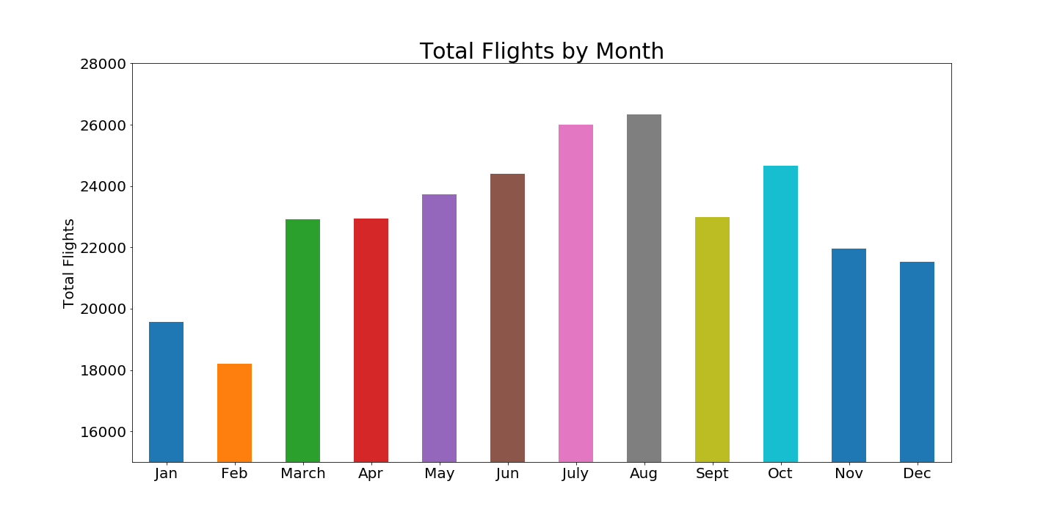

Slide 5
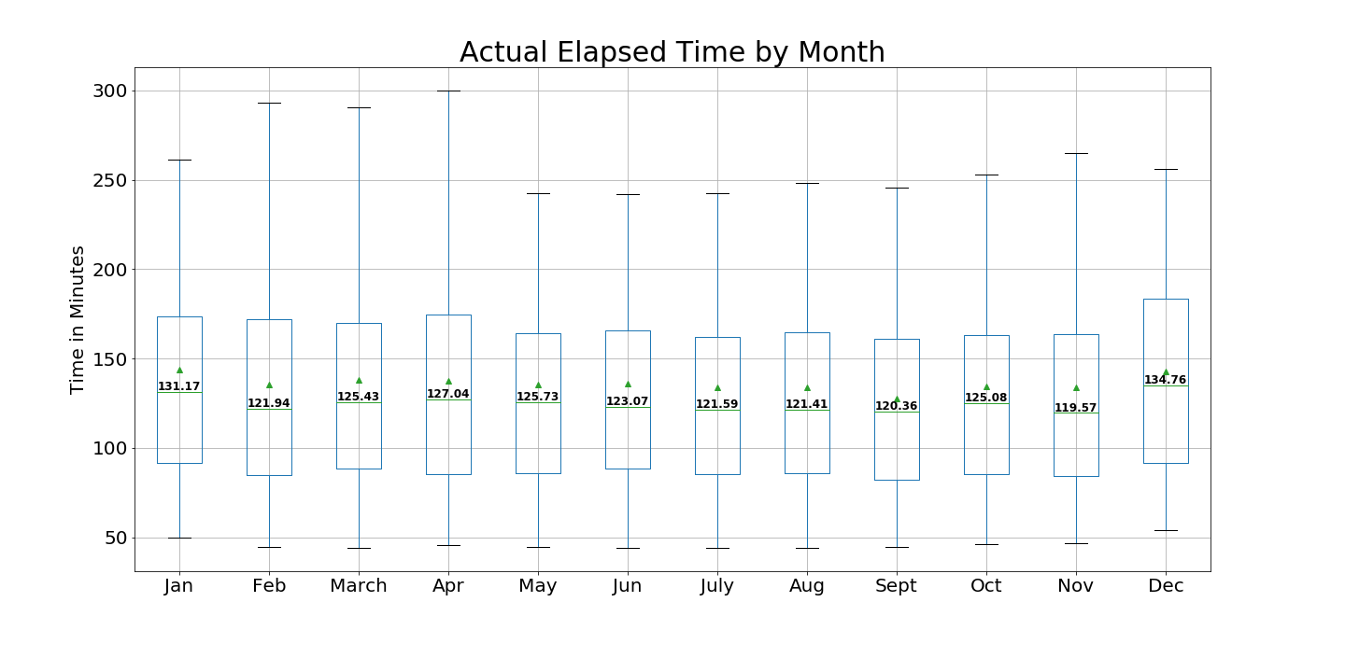

Slide 6
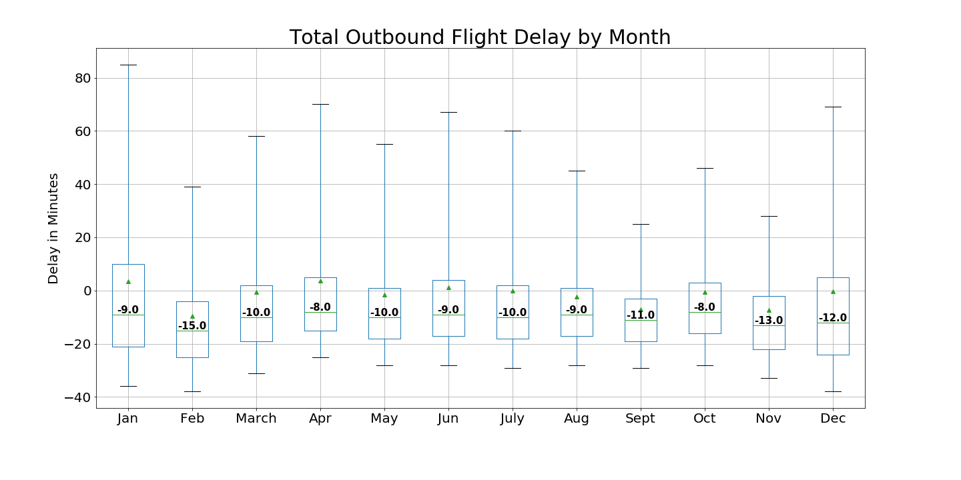

Slide 7
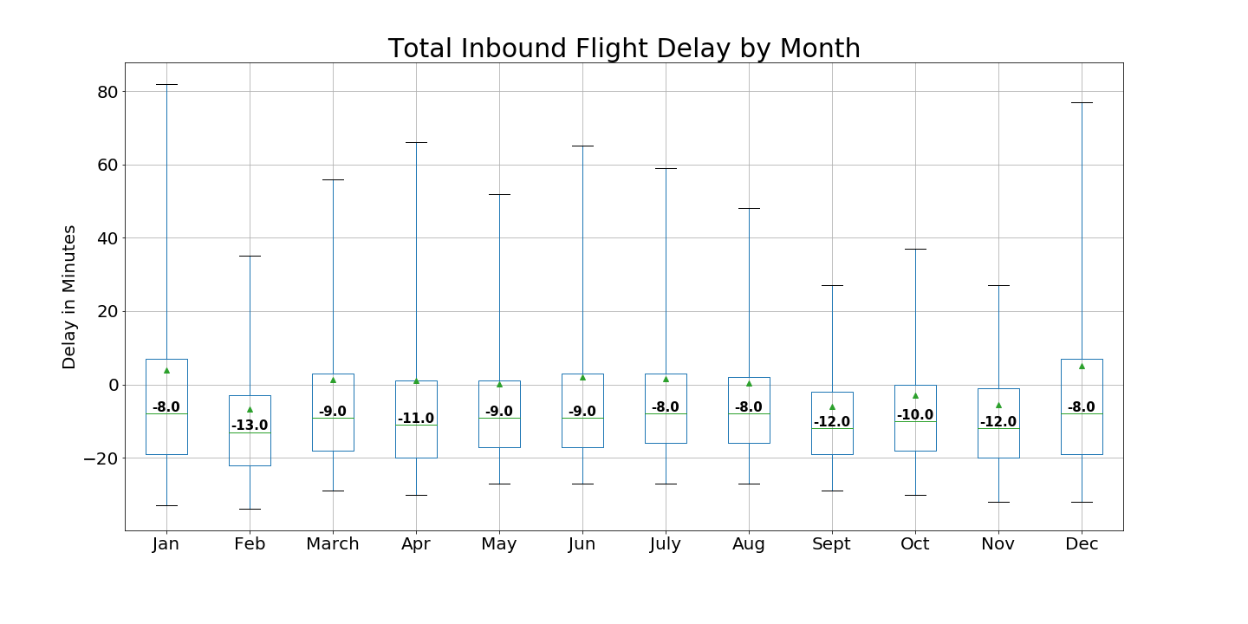

Slide 8
Monthly Conclusions
MSP Airport is the least busy in January/February
Flights in September/November are the least likely to be delayed
Flights leaving and arriving to MSP are most likely to be delayed in December/January/April

Slide 9
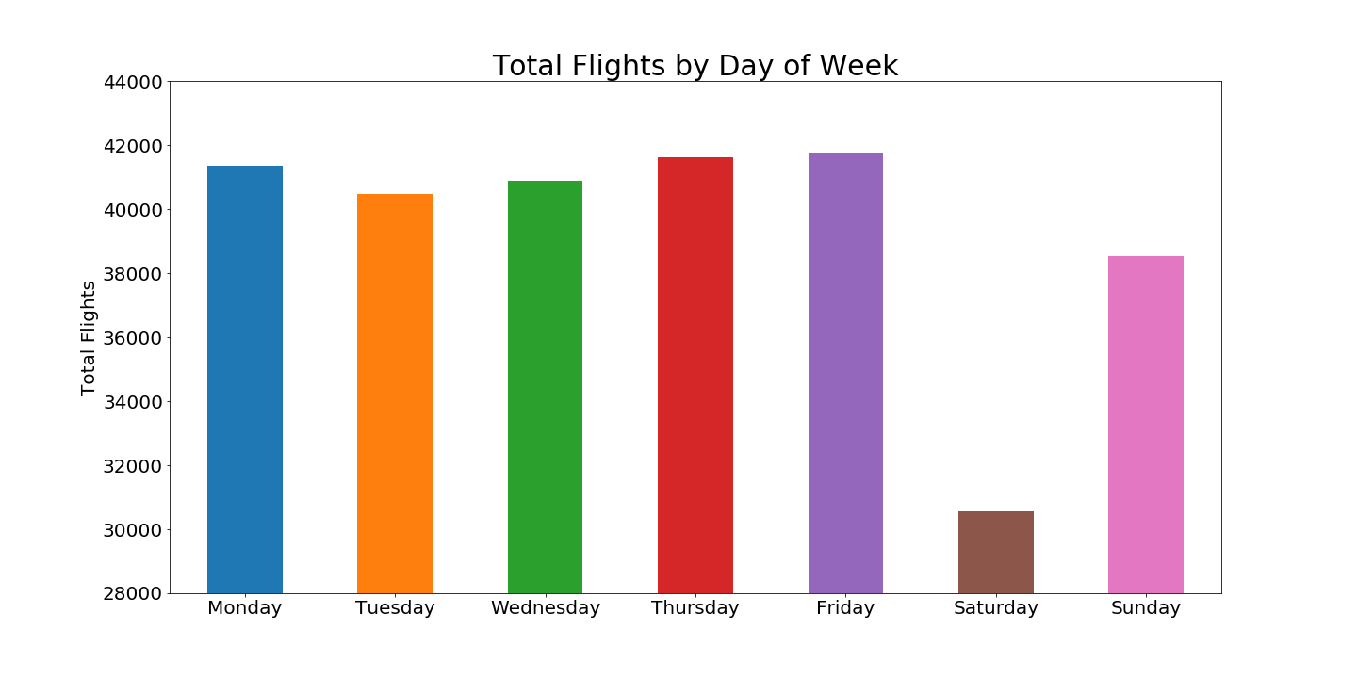

Slide 10
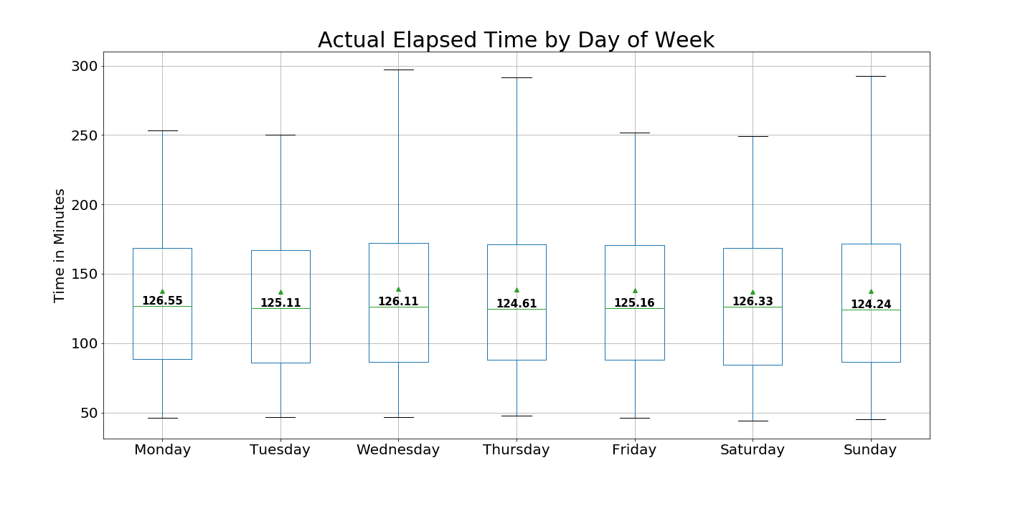

Slide 11
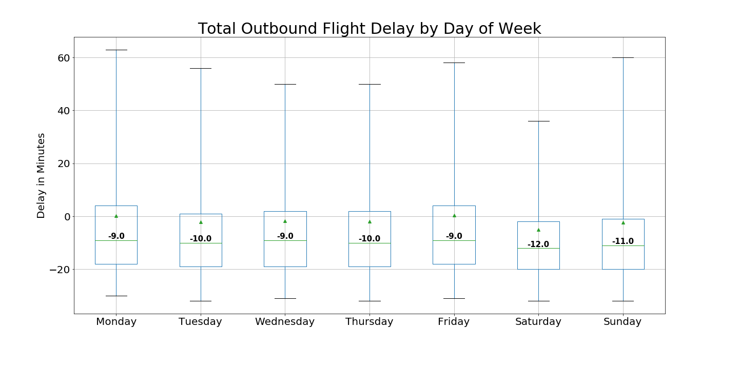

Slide 12
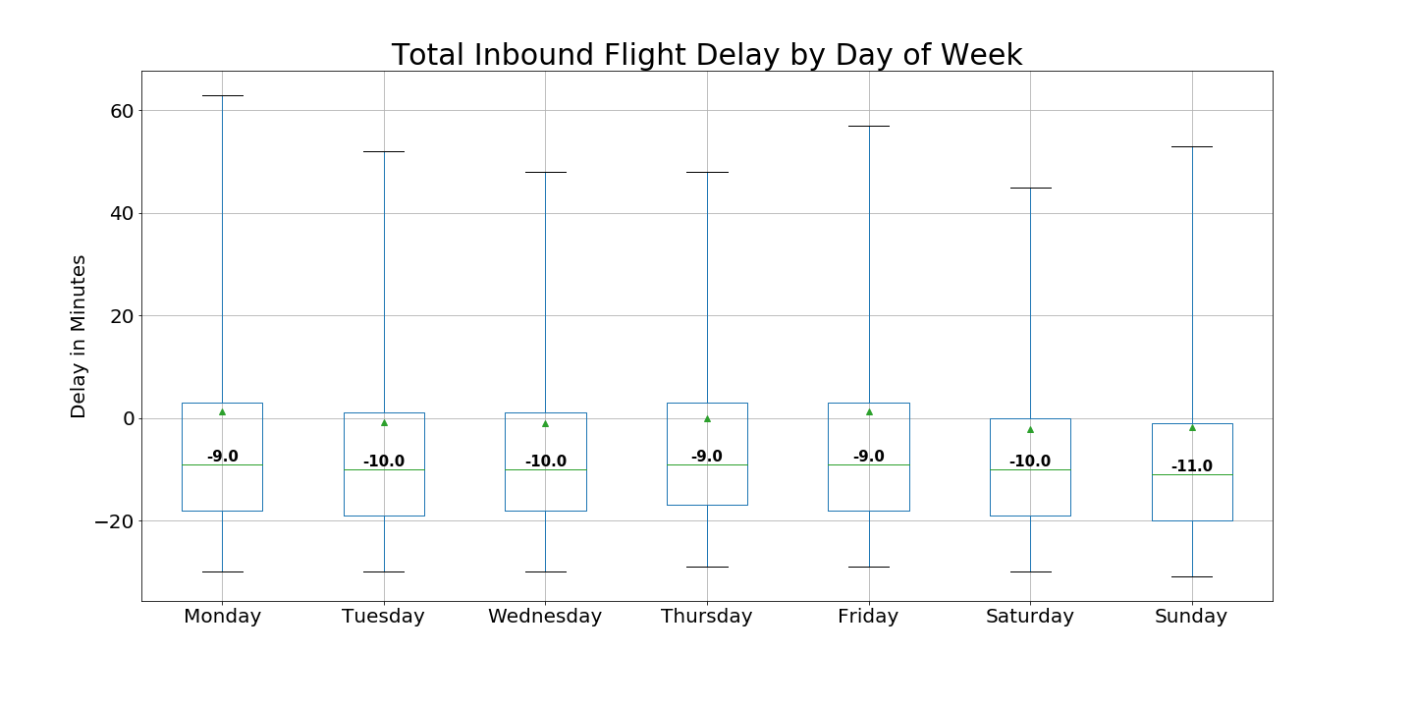

Slide 13
Daily Conclusions
Saturday and Sunday are the least busy days to fly
Saturday flight have the lowest outbound delays from MSP
Monday flights have the highest likelihood of being delayed

Slide 14
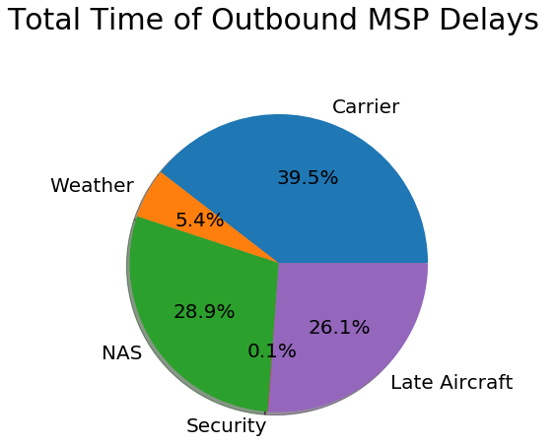
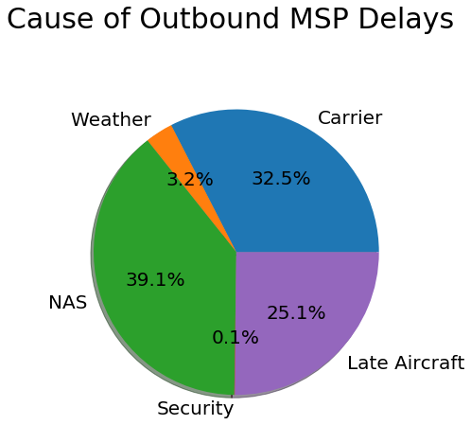

Slide 15
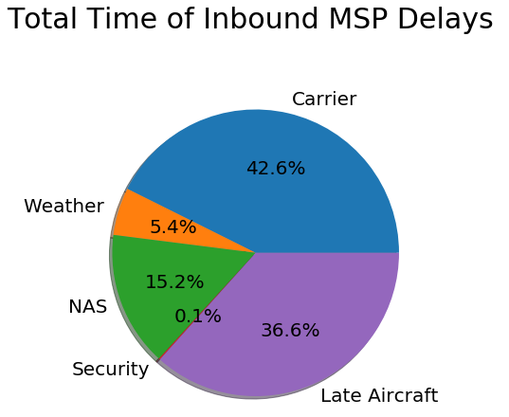
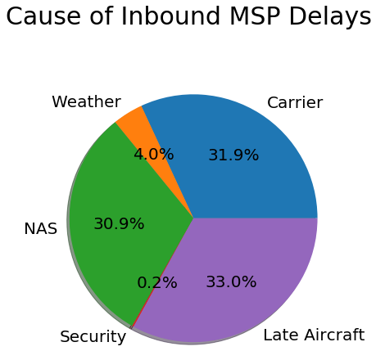
Most likely to be delayed by air traffic control but the delay will be shorter then a weather or carrier delay

Slide 16
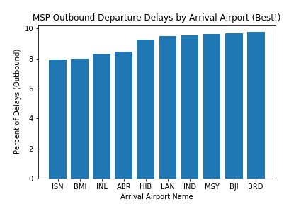
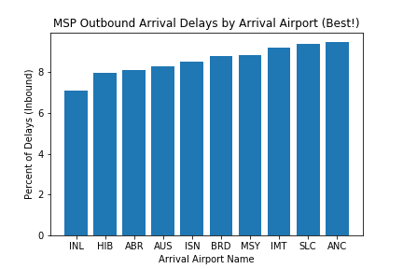
Airport Codes Key:
ISN: Williston, ND
BMI: Bloomington, IN
INL: International Falls, MN
ABR: Aberdeen, SD
HIB: Hibbing, MN
LAN: Lansing, MI
IND: Indianapolis, IN
MSY: New Orleans, LA
BJI: Bemidji, MN
BRD: Brainerd, MN
AUS: Austin, TX
IMT: Lansing, MI
SLC: Salt Lake City, UT
ANC: Anchorage, AK

Slide 17
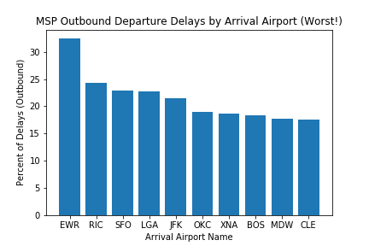
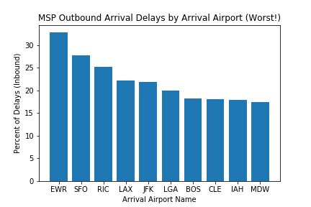
Airport Codes Key:
EWR: Newark, NJ
RIC: Richmond, VA
SFO: San Francisco, CA
LGA: New York LaGuardia, NY
JFK: New York John F. Kennedy, NY
OKC: Oklahoma City, OK
XNA: Bentonville, AK
BOS: Boston, MA
MDW: Chicago Midway, IL
CLE: Cleveland, OH
LAX: Los Angeles, CA
IAH: Houston, TX

Slide 18
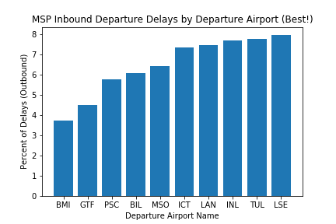
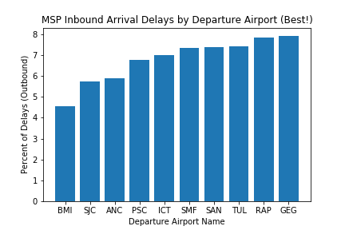
Airport Codes Key:
BMI: Bloomington, IN
GTF: Great Falls, MI
PSC: Pasco, WA
BIL: Billings, MT
MSO: Missoula, MT
ICT: Wichita, KS
LAN: Lansing, MI
INL: International Falls, MN
TUL: Tulsa, OK
LSE: La Crosse, WI
SJC: San Jose, CA
ANC: Anchorage, AK
SMF: Sacramento, CA
SAN: San Diego, CA
RAP: Rapid City, MI
GEG: Spokane, WA

Slide 19
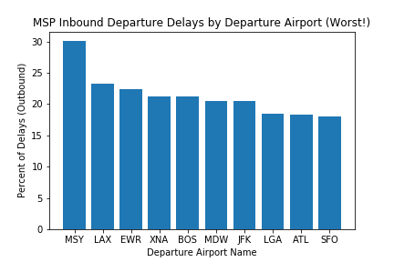
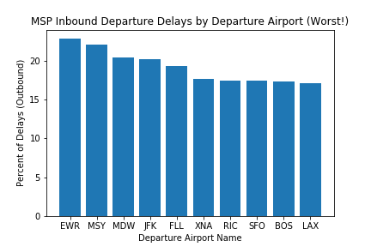
Airport Codes Key:
MSY: New Orleans, LA
LAX: Los Angeles, CA
EWR: Newark, NJ
XNA: Bentonville, AK
BOS: Boston, MA
MDW: Chicago Midway, IL
JFK: New York John F. Kennedy, NY
LGA: New York LaGuardia, NY
ATL: Atlanta, GA
SFO: San Francisco, CA
FLL: Fort Lauderdale, FL
RIC: Richmond, VA

Slide 20
Airport Conclusions
Smaller stations are the best ones to fly in and out of to avoid delays
There is a congregation of NE airports that have higher percentages of delays both out of and to MSP
The top ten for the best and the worst for both outbound and inbound are pretty consistent

Slide 21
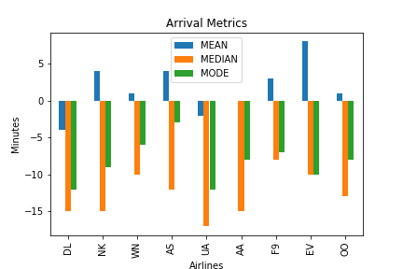
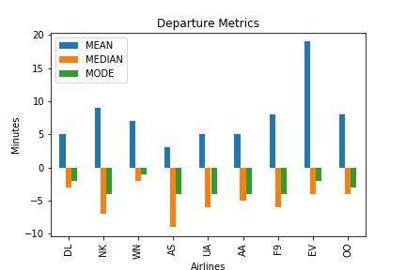
DELTA(DL) SPIRIT(NK) SOUTHWEST(WN)
ALASKAN(AS) UNITED(UA) AMERICAN(AA)
FRONTIER(F9) ENDEAVOR(EV) SKYWEST(OO)

Slide 22
Final Conclusions
Don’t like crowds?
Fly January/February
Fly Saturday and Sunday
Don’t like Delays?
Fly United, American, Alaskan on departure and try to arrive with Delta
Fly September/November,
Leave Saturday from MSP
Avoid Mondays
Not December/January/April (in/out of MSP)

